Slide 1
AI Application Problem
(ri_ReLU_mro)
Data

Slide 2
AI Application Problem
(ri_ReLU_mro)
Use q SLFNs, each of which has a single output node.
Make a new learning algorithm for a SLFN with q output nodes.

Slide 3
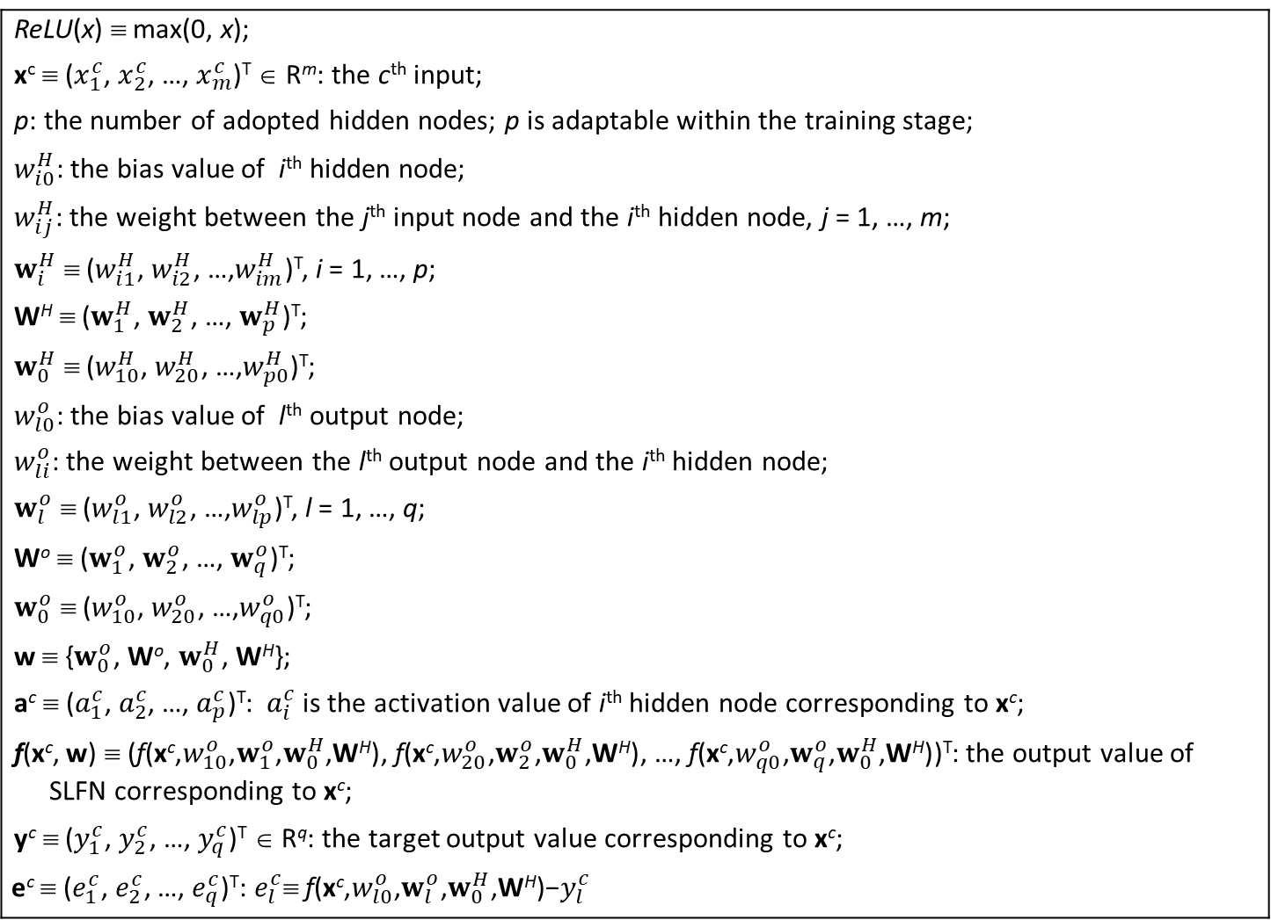
Assumption: the adaptive network
The network setting:
Two-layer nets / SLFN / One-hidden-layer nets
ReLU(x) ≡ max(0, x); x^{c} ≡ ($x_{1}^{c}$, $x_{2}^{c}$, …, $x_{m}^{c}$)^{T} ∈ R^{m}: the c^{th} input; p: the number of adopted hidden nodes; p is adaptable within the training stage; $w_{i0}^{H}$: the bias value of i^{th} hidden node; $w_{ij}^{H}$: the weight between the j^{th} input node and the i^{th} hidden node, j = 1, …, m; $w_{i}^{H}$ ≡ ($w_{i1}^{H}$, $w_{i2}^{H}$, …,$w_{im}^{H}$)^{T}, i = 1, …, p; W^{H} ≡ ($w_{1}^{H}$, $w_{2}^{H}$, …, $w_{p}^{H}$)^{T}; $w_{0}^{H}$ ≡ ($w_{10}^{H}$, $w_{20}^{H}$, …,$w_{p0}^{H}$)^{T}; $w_{l0}^{o}$: the bias value of l^{th} output node; $w_{li}^{o}$: the weight between the l^{th} output node and the i^{th} hidden node; $w_{l}^{o}$ ≡ ($w_{l1}^{o}$, $w_{l2}^{o}$, …,$w_{lp}^{o}$)^{T}, l = 1, …, q; Wº ≡ ($w_{1}^{o}$, $w_{2}^{o}$, …, $w_{q}^{o}$)^{T}; $w_{0}^{o}$ ≡ ($w_{10}^{o}$, $w_{20}^{o}$, …,$w_{q0}^{o}$)^{T}; w ≡ {$w_{0}^{o}$, Wº, $w_{0}^{H}$, W^{H}}; a^{c} ≡ ($a_{1}^{c}$,${ a}_{2}^{c}$, …, $a_{p}^{c}$)^{T}: $a_{i}^{c}$ is the activation value of i^{th} hidden node corresponding to x^{c}; f(x^{c},$\text{w}$) ≡ ($\text{f}\text{(}\text{x}\text{c}\text{,}w_{10}^{o}\text{,}w_{1}^{o}\text{,}w_{0}^{H}\text{,}\text{W}\text{H}\text{)}$, $\text{f}\text{(}\text{x}\text{c}\text{,}w_{20}^{o}\text{,}w_{2}^{o}\text{,}w_{0}^{H}\text{,}\text{W}\text{H}\text{)}$, …, $\text{f}\text{(}\text{x}\text{c}\text{,}w_{q0}^{o}\text{,}w_{q}^{o}\text{,}w_{0}^{H}\text{,}\text{W}\text{H}\text{)}$)^{T}: the output value of SLFN corresponding to x^{c}; y^{c} ≡ ($y_{1}^{c}$, $y_{2}^{c}$, …, $y_{q}^{c}$)^{T} ∈ R^{q}: the target output value corresponding to x^{c}; $$\text{e}\text{c} \text{≡}\text{ (}e_{1}^{c}\text{,}{ e}_{2}^{c}\text{, …,} e_{q}^{c}\text{)}\text{T}\text{:} e_{l}^{c}\text{≡} \text{f}\text{(}\text{x}\text{c}\text{,}w_{l0}^{o}\text{,}w_{l}^{o}\text{,}w_{0}^{H}\text{,}\text{W}\text{H}\text{)}\text{−}y_{l}^{c}$$
3

Slide 4





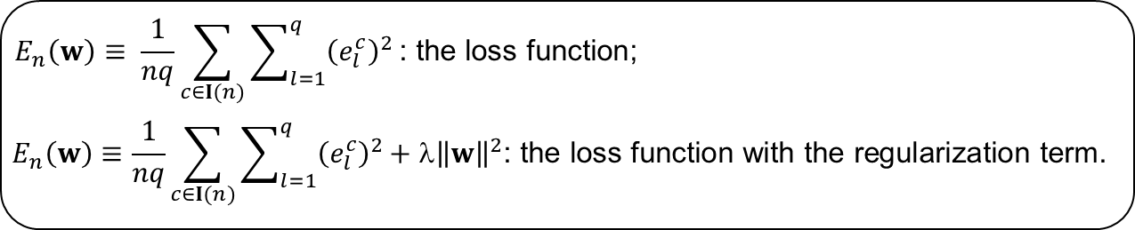
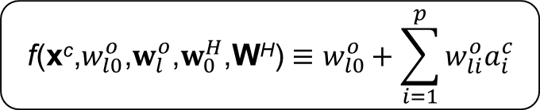
Forward operation
The forward operation setting
Hidden Layer
The hidden layer:
i
$$a_{i}^{c}≡\operatorname{ReLU}\left(w_{i0}^{H}+\sum_{j=1}^{m}{w_{ij}^{H}}x_{j}^{c}\right)$$
$$a≡\operatorname{ReLU}\left(W^{H}x+w_{0}^{H}\right)$$
Input Layer
$$x_{1}$$
$$x_{2}$$
$$x_{3}$$
…
$$x_{m}$$
Output Layer
The output layer:
l
$$\text{f}\text{(}\text{x}\text{c}\text{,}w_{l0}^{o}\text{,}w_{l}^{o}\text{,}w_{0}^{H}\text{,}\text{W}\text{H}\text{)}≡w_{l0}^{o}+\sum_{i=1}^{p}{w_{li}^{o}a_{i}^{c}}$$
Hidden Layer
1
2
…
p
$$E_{n}\left(w\right)≡ \frac{1}{nq}\sum_{c∈I(n)}{\sum_{l=1}^{q}{{\left(e_{l}^{c}\right)}^{2}}}\text{: }\text{the} \text{loss} \text{function}\text{;}$$
$$E_{n}\left(w\right)≡\frac{1}{nq}\sum_{c∈I(n)}{\sum_{l=1}^{q}{{\left(e_{l}^{c}\right)}^{2}}}\text{+ }\text{λ}{\left\|w\right\|}^{2}\text{: }\text{the} \text{loss} \text{function} \text{with} \text{the} \text{regularization} \text{term}\text{.}$$
Notes:
The Single-hidden layer Feedforward Neural Networks (SLFN) structure

Slide 5



The learning goal of the n^{th} stage
learning goal:
|$e_{l}^{c}$| ≡ |$\text{f}\text{(}\text{x}\text{c}\text{,}w_{l0}^{o}\text{,}w_{l}^{o}\text{,}w_{0}^{H}\text{,}\text{W}\text{H}\text{)}$-$y_{l}^{c}$| ≤ $\text{ε}$ ∀ c ∈$I$(n) ∀ l
inferencing goal:
|$\text{f}\text{(}\text{x}\text{c}\text{,}w_{l0}^{o}\text{,}w_{l}^{o}\text{,}w_{0}^{H}\text{,}\text{W}\text{H}\text{)}$-$y_{l}^{c}$| ≤ $\text{ε}$ ∀ c ∈$I(N) \text{∀} \text{l}$
The acceptance is |$e_{l}^{c}$| $≤\text{ε}$ ∀ c ∈$I$(n) ∀ l

Slide 6
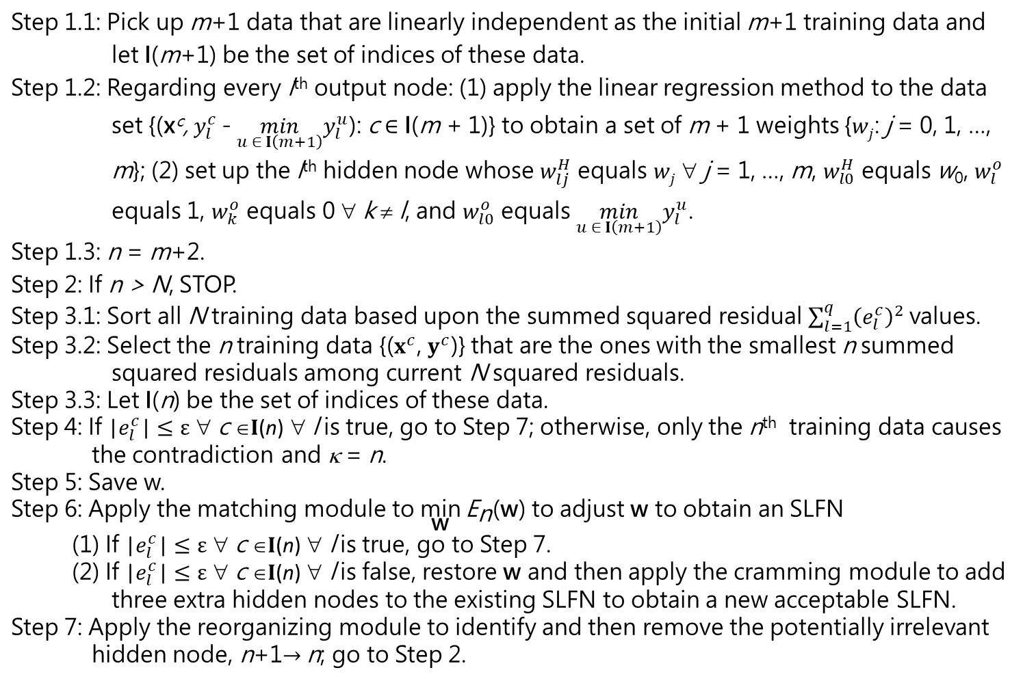
The proposed learning algorithm
Step 1.1: Pick up m+1 data that are linearly independent as the initial m+1 training data and let I(m+1) be the set of indices of these data. Step 1.2: Regarding every l^{th} output node: (1) apply the linear regression method to the data set {(x^{c}, $y_{l}^{c}$ - $\min_{u ∈ I\left(m+1\right)}y_{l}^{u}$): c ∈ I(m + 1)} to obtain a set of m + 1 weights {$wj$: j = 0, 1, …, m}; (2) set up the l^{th} hidden node whose $w_{lj}^{H}$ equals $wj$ ∀ j = 1, …, m, $w_{l0}^{H}$ equals w₀, $w_{l}^{o}$ equals 1, $w_{k}^{o}$ equals 0 ∀ k ≠ l, and $w_{l0}^{o}$ equals $\min_{u ∈ I\left(m+1\right)}y_{l}^{u}$. Step 1.3: n = m+2. Step 2: If n > N, STOP. Step 3.1: Sort all N training data based upon the summed squared residual $\sum_{l=1}^{q}{{\left(e_{l}^{c}\right)}^{2}}$values. Step 3.2: Select the n training data {($x^{c}$, $y^{c}$)} that are the ones with the smallest n summed squared residuals among current N squared residuals. Step 3.3: Let I(n) be the set of indices of these data. Step 4: If |$e_{l}^{c}$| $≤\text{ε}$ ∀ c ∈$I$(n) ∀ l is true, go to Step 7; otherwise, only the n^{th} training data causes the contradiction and κ = n. Step 5: Save w. Step 6: Apply the matching module to $\underset{\text{w}}{\text{min}}{{\text{E}}_{\text{n}}\text{(}\text{w}\text{)}}$ to adjust w to obtain an SLFN (1) If |$e_{l}^{c}$| $≤\text{ε}$ ∀ c ∈$I$(n) ∀ l is true, go to Step 7. (2) If |$e_{l}^{c}$| $≤\text{ε}$ ∀ c ∈$I$(n) ∀ l is false, restore w and then apply the cramming module to add three extra hidden nodes to the existing SLFN to obtain a new acceptable SLFN. Step 7: Apply the reorganizing module to identify and then remove the potentially irrelevant hidden node, n+1$→$n; go to Step 2.

Slide 7
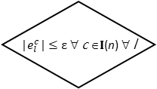

The proposed learning algorithm
(in flowchart)
True
n ≥ N
False
$${LTS}_{n}^{N}$$
|$e_{l}^{c}$| $≤\text{ε}$ ∀ c ∈$I$(n) ∀ l
False
Save w
True
Matching
A
n ++
Reorganizing
Cramming
Restore w
B
Initializing
7

Slide 8

The initializing module
Step 1: Pick up m+1 data that are linearly independent as the initial m+1 training data and let I(m+1) be the set of indices of these data.
Step 2: Regarding every l^{th} output node: (1) apply the linear regression method to the data set {(x^{c}, $y_{l}^{c}$ - $\min_{u ∈ I\left(m+1\right)}y_{l}^{u}$): c ∈ I(m + 1)} to obtain a set of m + 1 weights {$wj$: j = 0, 1, …, m}; (2) set up the l^{th} hidden node whose $w_{lj}^{H}$ equals $wj$ ∀ j = 1, …, m, $w_{l0}^{H}$ equals w₀, $w_{l}^{o}$ equals 1, $w_{k}^{o}$ equals 0 ∀ k ≠ l, and $w_{l0}^{o}$ equals $\min_{u ∈ I\left(m+1\right)}y_{l}^{u}$.
Step 3: n = m+2.
In Step 2, the corresponding set of simultaneous linear equations is a system of m + 1 linear equations in m + 1 unknowns:
w₀ + $\sum_{j=1}^{m}{wj{ x}_{j}^{c}}=$ $y_{l}^{c}$ - $\min_{u ∈ I\left(m+1\right)}y_{l}^{u}$ ∀ c ∈ I(m + 1)
This setup of SLFN with q hidden nodes renders ($e_{l}^{c}$)² = 0 ∀ c ∈ I(m + 1) ∀ l

Slide 9


The ${LTS}_{n}^{N}$ module
The stopping criterion
If n > N, STOP.
At the n^{th} stage,
Step 1: Sort all N training data based upon the summed squared residual $\sum_{l=1}^{q}{{\left(e_{l}^{c}\right)}^{2}}$values.
Step 2: Select the n training data {($x^{c}$, $y^{c}$)} that are the ones with the smallest n summed squared residuals among current N squared residuals.
Step 3: Let I(n) be the set of indices of these data.

Slide 10
The learning goal
|$e_{l}^{c}$| $≤\text{ε}$ ∀ c ∈$I$(n) ∀ l
The save module
Save w
The restore module
Restore the saved w

Slide 11
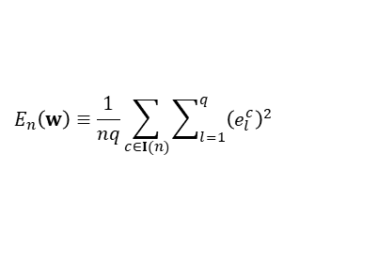
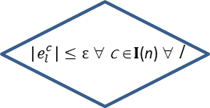
The matching module
Hyperparameters:
100
Optimizer (Adam)
ε = 0.001
$$E_{n}\left(w\right)≡\frac{1}{nq}\sum_{c∈I(n)}{\sum_{l=1}^{q}{{\left(e_{l}^{c}\right)}^{2}}}$$
i = 1
i++
forward
operation
False
i ≥ 100
|$e_{l}^{c}$| $≤\text{ε}$ ∀ c ∈$I$(n) ∀ l
backward operation
False
True
True
B
Unacceptable net
Acceptable net
A

Slide 12
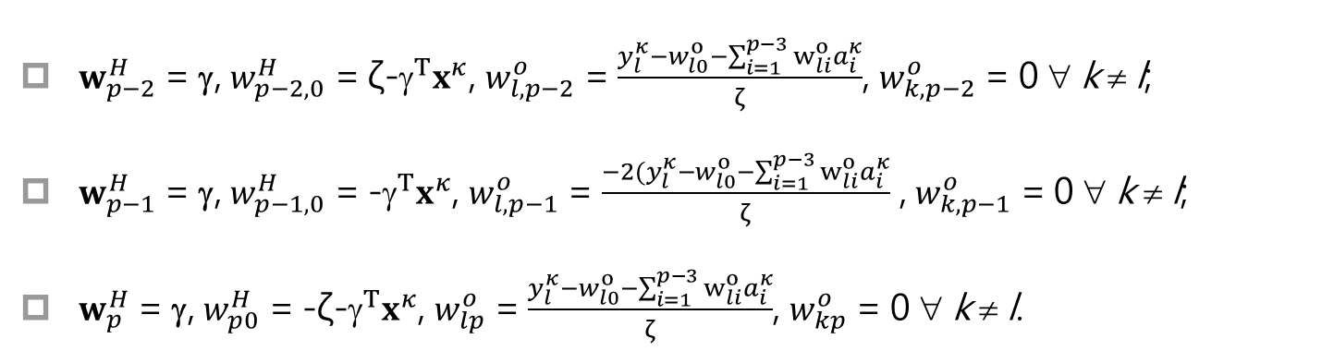
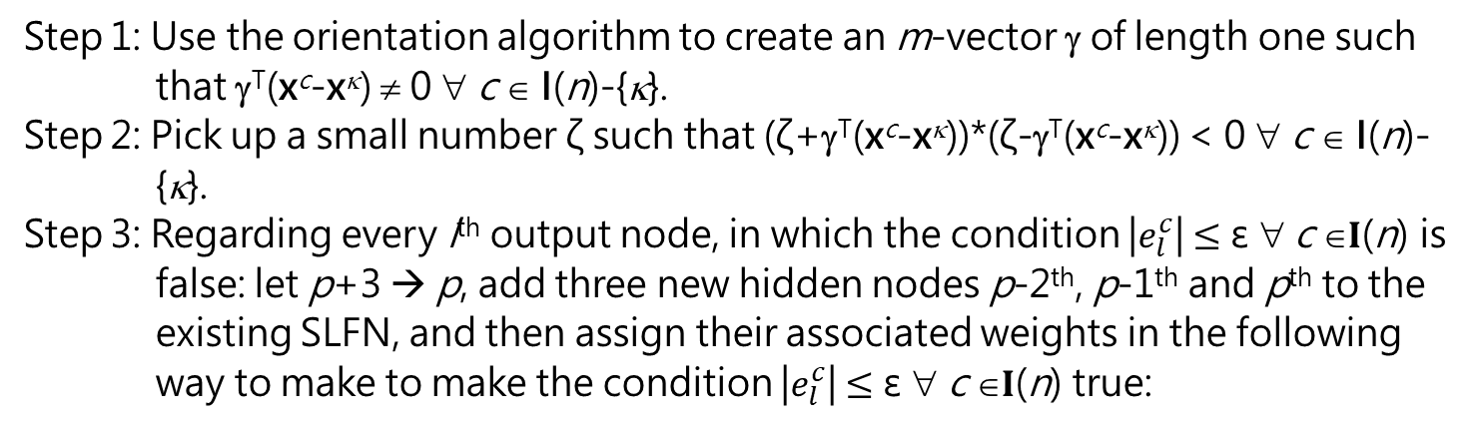
The cramming module
Step 1: Use the orientation algorithm to create an m-vector γ of length one such that γ^{T}(x^{c}-x^{κ}) ≠ 0 ∀ c ∈ I(n)-{κ}.
Step 2: Pick up a small number ζ such that (ζ+γ^{T}(x^{c}-x^{κ}))*(ζ-γ^{T}(x^{c}-x^{κ})) < 0 ∀ c ∈ I(n)-{κ}.
Step 3: Regarding every l^{th} output node, in which the condition |$e_{l}^{c}$| $≤\text{ε}$ ∀ c ∈$I$(n) is false: let p+3 → p, add three new hidden nodes p-2th, p-1th and p^{th} to the existing SLFN, and then assign their associated weights in the following way to make to make the condition |$e_{l}^{c}$| $≤\text{ε}$ ∀ c ∈$I$(n) true:
$w_{p−2}^{H}$ = γ, $w_{p−2,0}^{H}$ = ζ-$^{T}x^{κ}$, $w_{l,p−2}^{o}$ = $\frac{y_{l}^{κ}−w_{l0}^{o}−\sum_{i=1}^{p−3}{w_{li}^{o}a_{i}^{κ}}}{ζ}$, $w_{k,p−2}^{o}$ = 0 ∀ k ≠ l;
$w_{p−1}^{H}$ = γ, $w_{p−1,0}^{H}$ = -$^{T}x^{κ}$, $w_{l,p−1}^{o}$ = $\frac{−2(y_{l}^{κ}−w_{l0}^{o}−\sum_{i=1}^{p−3}{w_{li}^{o}a_{i}^{κ}}}{ζ}$ , $w_{k,p−1}^{o}$ = 0 ∀ k ≠ l;
$w_{p}^{H}$ = γ, $w_{p0}^{H}$ = -ζ-$^{T}x^{κ}$, $w_{lp}^{o}$ = $\frac{y_{l}^{κ}−w_{l0}^{o}−\sum_{i=1}^{p−3}{w_{li}^{o}a_{i}^{κ}}}{ζ}$, $w_{kp}^{o}$ = 0 ∀ k ≠ l.

Slide 13
The cramming module
Step 1: Use the orientation algorithm to create an m-vector γ of length one such that γ^{T}(x^{c}-x^{κ}) ≠ 0 ∀ c ∈ I(n)-{κ}.
Step 2: Pick up a small number ζ such that (ζ+γ^{T}(x^{c}-x^{κ}))*(ζ-γ^{T}(x^{c}-x^{κ})) < 0 ∀ c ∈ I(n)-{κ}.
Pick up a small number ζ and then use the random number algorithm to create an m-vector γ of length one such that γ^{T}(x^{c}-x^{κ}) ≠ 0 ∀ c ∈ I(n)-{κ} AND (ζ+γ^{T}(x^{c}-x^{κ}))*(ζ-γ^{T}(x^{c}-x^{κ})) < 0 ∀ c ∈ I(n)-{κ}.
13

Slide 14


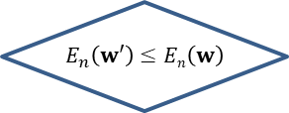
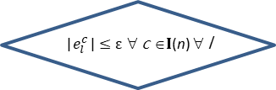


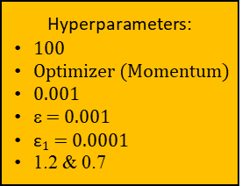
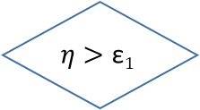

$$E_{n}\left(w\right)≡\frac{1}{nq}\sum_{c∈I(n)}{\sum_{l=1}^{q}{{\left(e_{l}^{c}\right)}^{2}}}\text{+}\frac{\text{0.001}}{p+1+p(m+1)}\text{(}\sum_{i=0}^{p}{\text{(}w_{i}^{o}\text{)}\text{2}}\text{ + }\sum_{i=1}^{p}{\sum_{j=0}^{m}{{(w}_{ij}^{H}}\text{)}\text{2}}\text{)}$$
The regularizing module
An acceptable net that accomplishes the learning goal
$$η$$
i = 1
An acceptable net that has a preference on weights
True
i ≥ 100
False
Store w
Hyperparameters:
100
Optimizer (Momentum)
0.001
ε = 0.001
$\text{ε}1$ = 0.0001
1.2 & 0.7
backward operation to obtain $w′$
$w^{′}→w$ $$1.2 η→η$$
i+1 $→$ i
forward operation
Restore w
& $0.7η→η$
$$E_{n}\left(w′\right)≤En\left(w\right)$$
|$e_{l}^{c}$| $≤\text{ε}$ ∀ c ∈$I$(n) ∀ l
True
True
False
False
True
$$η>\text{ε}1$$
False
Restore w
An acceptable net that has a preference on weights

Slide 15
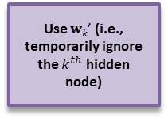
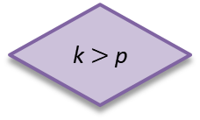
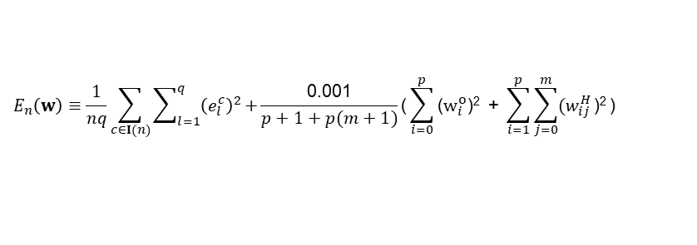


$$E_{n}\left(w\right)≡\frac{1}{nq}\sum_{c∈I(n)}{\sum_{l=1}^{q}{{\left(e_{l}^{c}\right)}^{2}}}$$
The reorganizing module
$$E_{n}\left(w\right)≡\frac{1}{nq}\sum_{c∈I(n)}{\sum_{l=1}^{q}{{\left(e_{l}^{c}\right)}^{2}}}\text{+}\frac{\text{0.001}}{p+1+p(m+1)}\text{(}\sum_{i=0}^{p}{\text{(}w_{i}^{o}\text{)}\text{2}}\text{ + }\sum_{i=1}^{p}{\sum_{j=0}^{m}{{(w}_{ij}^{H}}\text{)}\text{2}}\text{)}$$
k ++
Restore the network and w
Hyperparameters:
100
Two optimizers (Momentum & Adam)
0.001
Two sets of ε & $\text{ε}1$
(ε = 0.001; $\text{ε}1$ = 0.0001)
Two sets of 1.2 & 0.7
p --
A
B
An acceptable SLFN
k = 1
k $>$p
False
regularizing module
Store the network and w
Use $wk\text{’}$ (i.e., temporarily ignore the $k^{th}$ hidden node)
matching module
True
An acceptable SLFN
Different loss functions!

